Slide 1
Team 808: Scalable Electrosurgical Unit
(SESU)
Critical Design Review
Notes:
Sonal

Slide 2

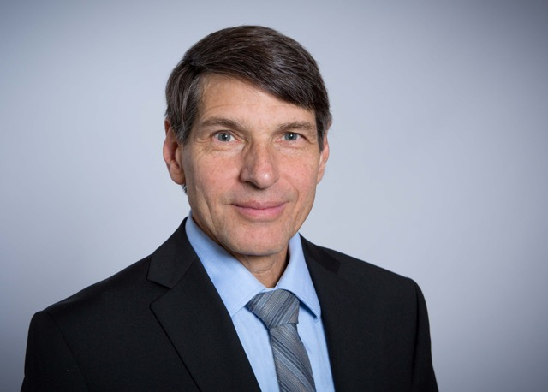






Team
808
Sonal Tamrakar - Team Lead
Ali Moran -
Product Manual Editor
Keith Malang - Technical Advisor
Noah Zhao - Communications Manager
Rustin Chang - Hardware Lead
Daniel Chun
Financial Manager
Morale Manager
Chengming - Software Lead
Notes:
Sonal

Slide 3
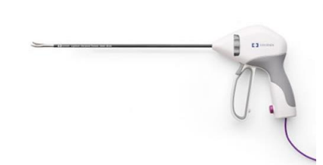
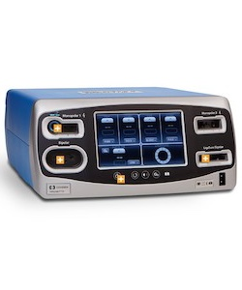
Elevator Pitch
FT10 Generator
Notes:
Sonal: An electrosurgical unit, or an ESU, is an incision device that is used to cut, cauterize and remove organic tissue efficiently while controlling the bleeding. An RF signal is delivered to the two ends of the handheld device that does the cauterization. As it currently stands, for many low-to-middle income countries, getting access to these electrosurgical units is difficult due to the power generator’s large size and steep cost. Our project goal is to create an electrosurgical unit which is low-cost, space efficient, and portable.

Slide 4
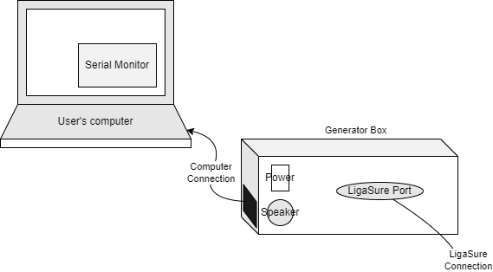
Project Overview
System in Use
When not in use, generator and bizact are disconnected & bizact disposed
Notes:
Noah
Here is a simplified graphic of what our system will look like in operation. We have our generator with ports for connecting to a laptop so that it can display measurements that the user will need such as impedance and rms voltage values. There will be a port for the ligasure device

Slide 5
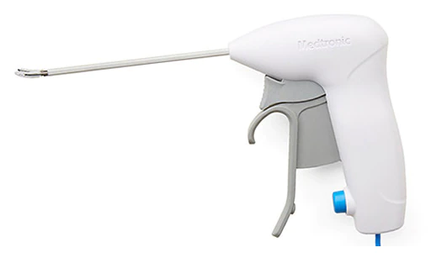
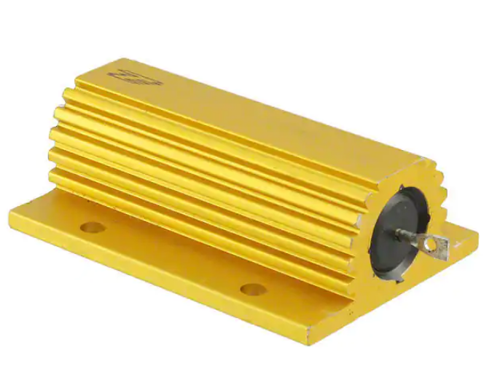
Key Features and Demonstration Plan
Bizact demonstration - Bacon & Egg
Variable loads at output terminals
Impedance measurements on GUI
Notes:
Noah

Slide 6
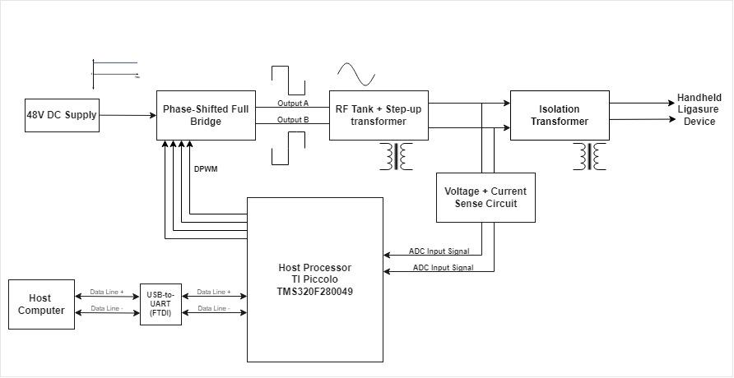
System Diagram
Notes:
Here’s the system diagram of our project.

Slide 7
System Diagram
Notes:
We have a +48 V DC supply that’s powering the phase shifted full bridge.

Slide 8
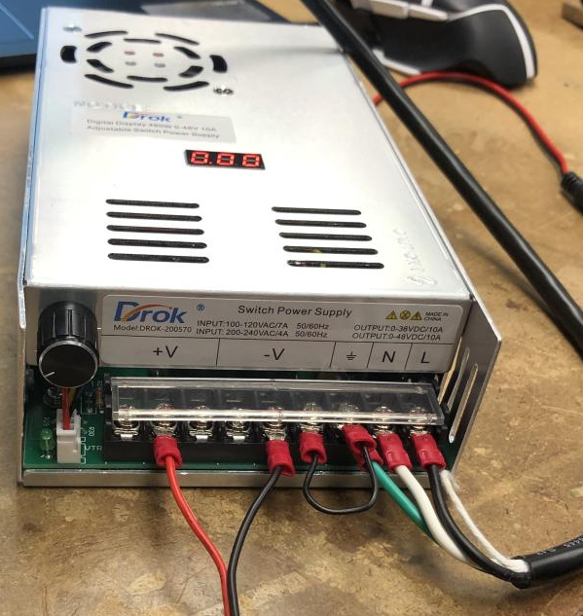
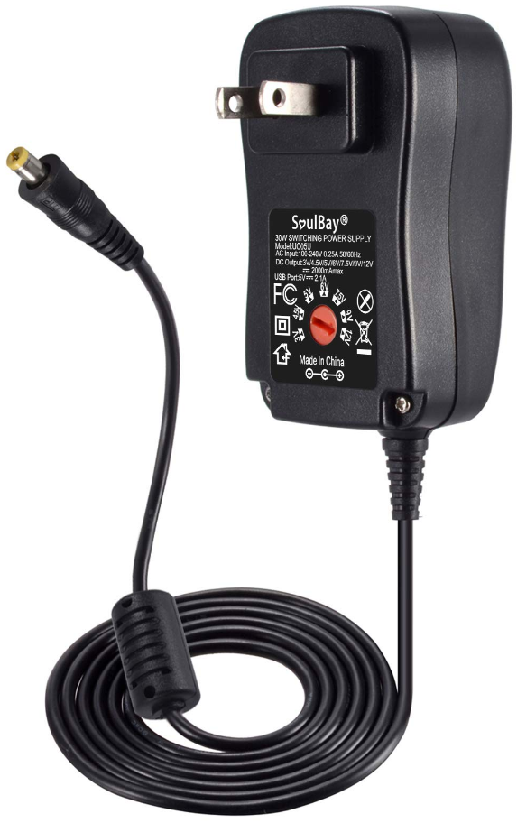
+48V DC Power Supply
Output: 0-48 VDC / 10A powering the bridge
12V powering the rest of the system
Notes:
Sonal- The rest of the system is being powered with a 12V wall adapter, such as the MCU and the sensor circuitry.

Slide 9
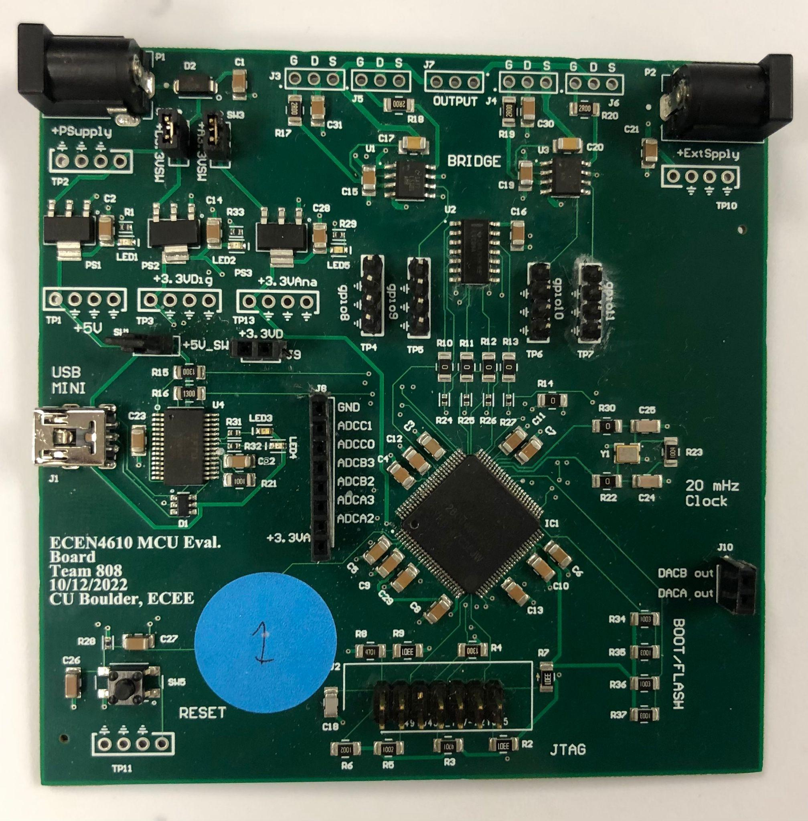
System Diagram
Notes:
Sonal: The first part of our design is the Phase-Shifted Full Bridge

Slide 10
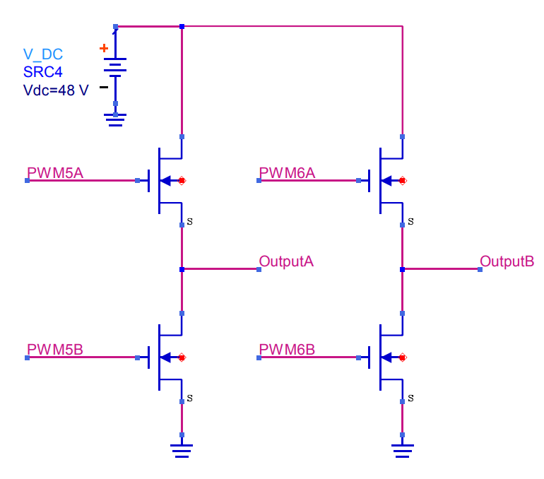
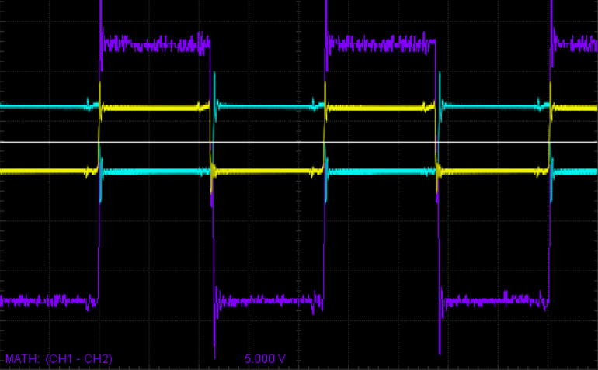
Phase-Shifted Full Bridge Operation
PWM5A & PWM5B complement pair
PWM6A & PWM6B complement pair
PWM6 phase shifted relative to PWM5
OutputA : —-------------------
OutputA - OutputB: —-------------------
OutputB : —-------------------
+48 V
-48 V
Notes:
Sonal : The inputs to the phase-shifted full bridge are the 4 PWM signals out of our microcontroller that’s running at 430 kHz. We are expecting 2 outputs out of the phase shifted full bridge which will create a 96 VOLT PEAK TO PEAK BIPOLAR SQUARE WAVE WITH A VARIABLE DUTY CYCLE BASED UPON THE PHASE between the two PWM pairs.

Slide 11
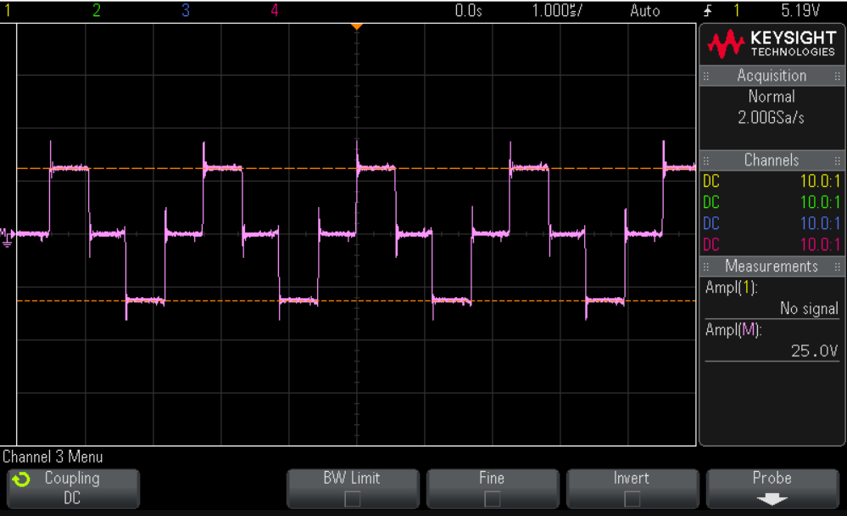
Phase-Shifted Full Bridge Operation with Phase
PWM5A - —---------------
PWM5B - —---------------
PWM6A - —---------------
PWM6B - —---------------
90 degree phase shift
Notes:
Sonal- The phase shift is achieved by shifting PWM6 pair relative to PWM5 pair.

Slide 12
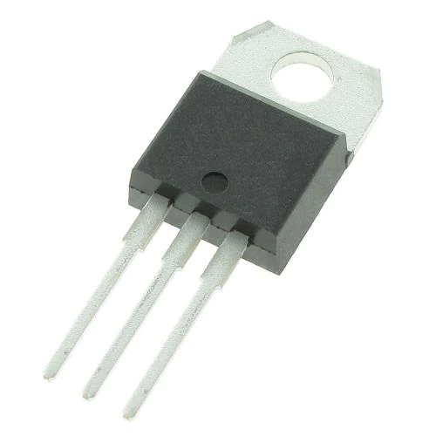
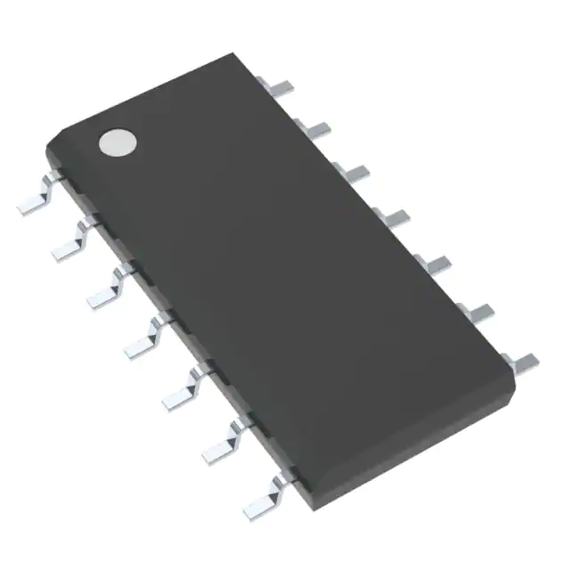
Phase-Shifted Full Bridge Technologies
MOSFET: TK3R2E06PL
3-terminal N-channel MOSFET
Max VDS - 60V
Gate Drivers: LM5101AMR/NOPB
Drives high-side/low-side N-channel MOSFETS
Notes:
Noah
MOSFETs rated for max VDS is 60V but for our applications our max is 48V and our supply max is 48V

Slide 13
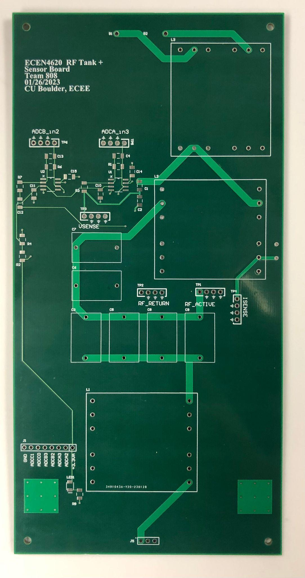
System Diagram
Notes:
Rustin + Daniel

Slide 14
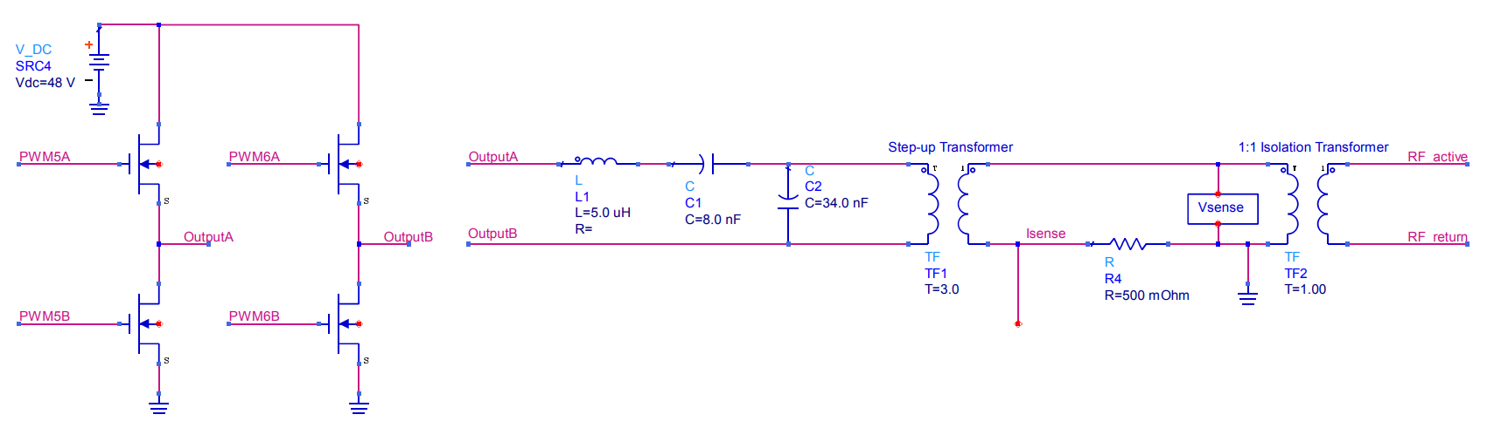
RF Tank/Transformers
Notes:
Rustin + Daniel

Slide 15
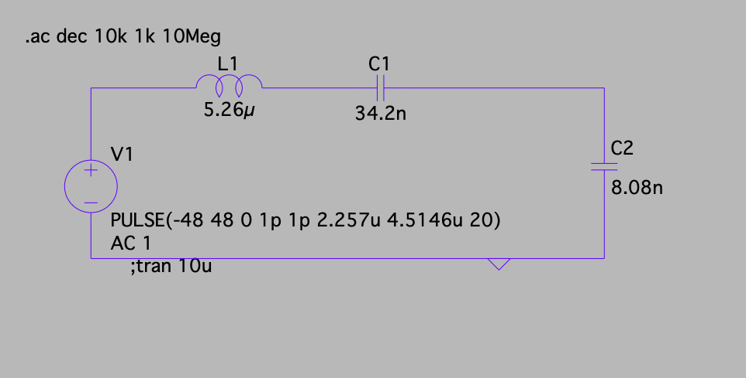
RF Tank
L = 5.2µH, C₁ = 8.08nF, C₂ = 34.2nF
Resonance at 860 kHz, which is the 2nd harmonic (square wave only consists of odd harmonics)
This filters the non-fundamental harmonics without adding resonance to our signal.
This sinusoidal wave will then go through a step up transformer
Notes:
Rustin + Daniel: These values will achieve a resonance at 863310 Hz (863kHz), which is approximately the 2nd harmonic of our pseudo-square wave. Since the FS of a square wave is odd, this filter then successfully filters the non-fundamental harmonics without adding resonance to our signal.

Slide 16
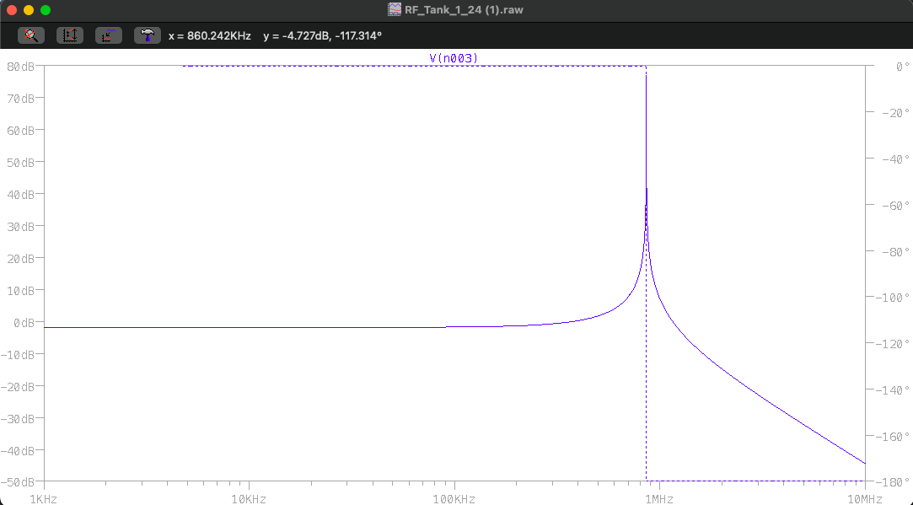
RF Tank Circuit Output
Output shows resonance at the 2nd harmonic
Square Wave is an odd FS and hence does not have a harmonic at 860 kHz
Notes:
Rustin + Daniel: When we combine C1 and C2 in series, we can calculate the total circuit like an LCC to get the actual pole we see in the Bode plot

Slide 17
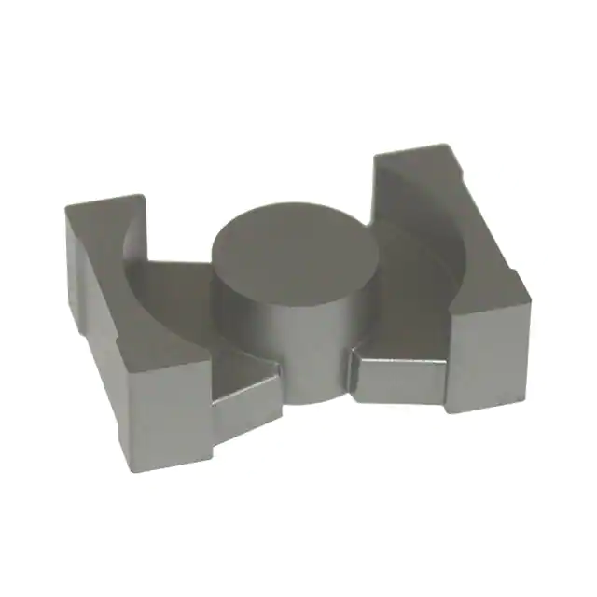
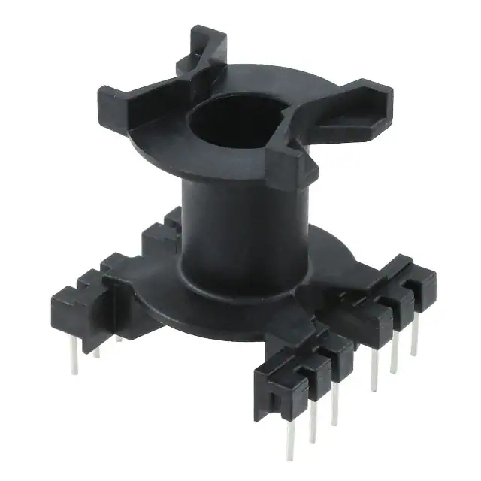
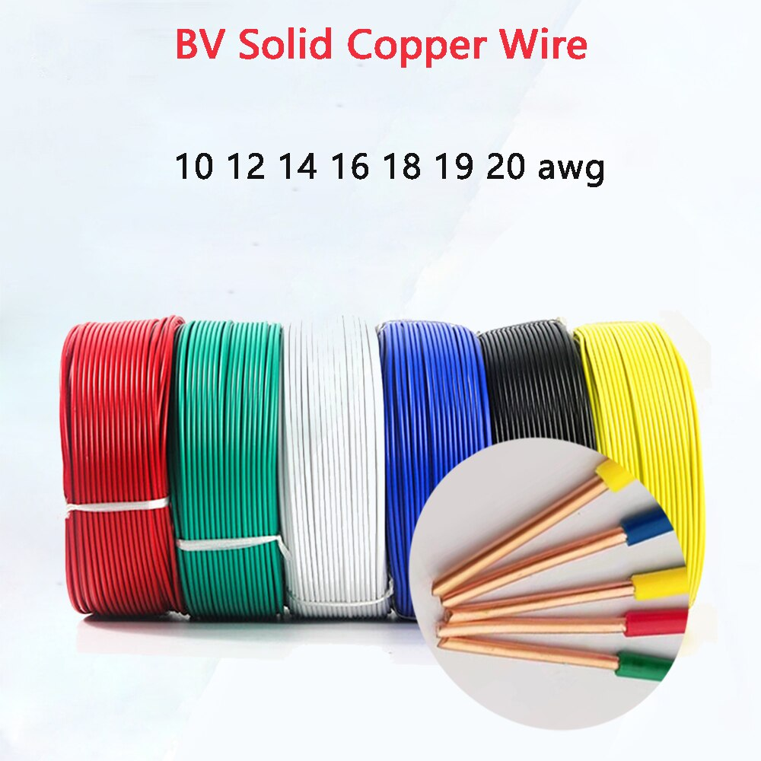
Transformers/Inductors
PQ35/35 Ferrite Core
CPV-PQ35/35 (Bobbin)
Wire
Notes:
Rustin + Daniel

Slide 18
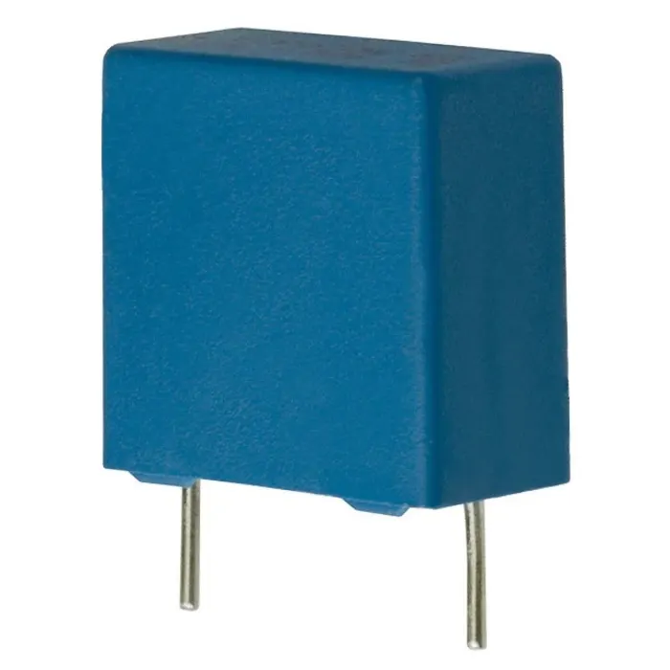
Transformers/Inductors
Parameters
Hardware
Step-Up (1:2.5)
Primary: 4
Secondary: 10
Isolation (1:1)
Primary: 3
Secondary: 3
Custom Inductors and Transformers
Low ESR Film Capacitors
TDK B32671L
1% tolerance
Notes:
Rustin + Daniel: Essentially we designed for one goal and one goal only and that was to not saturate the core. As long as we didn’t saturate the core we would have a working transformer. Therefore, we designed for the minimum number of wire turns for our two transformers to prevent it from saturation.

Slide 19
System Diagram
Notes:
Rustin + Daniel

Slide 20
Voltage and Current Sensors
Notes:
Daniel

Slide 21
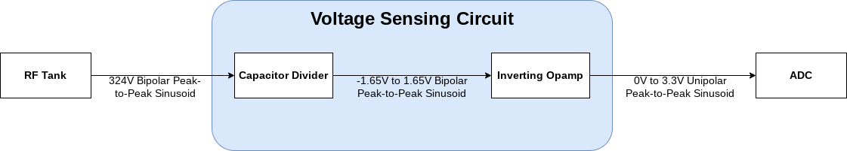
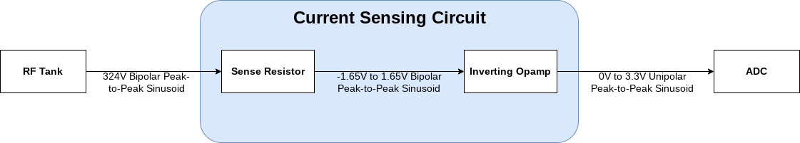
Voltage and Current Sensor
Notes:
Daniel:
So from the RF tank, we are going to get a 324V peak-to-peak sine wave
The reason why is because first off, if we limit ourselves to the fundamental harmonic, we find that the amplitude is 4*V_g/pi. Hence since our V_g is 48V from the phase-shifted full bridge, we get about 61V with an RMS of approximately 43V. Additionally, we found that the transfer function of our RF tank would be approximately 1.08. Therefore, 1.08 * 2.5 (our turns ratio for the step-up transformer) * 43V RMS we get about a 115V RMS as our voltage output on the secondary side of the transformer. Hence, we would have approximately a 162V peak and a 324V peak-to-peak output

Slide 22
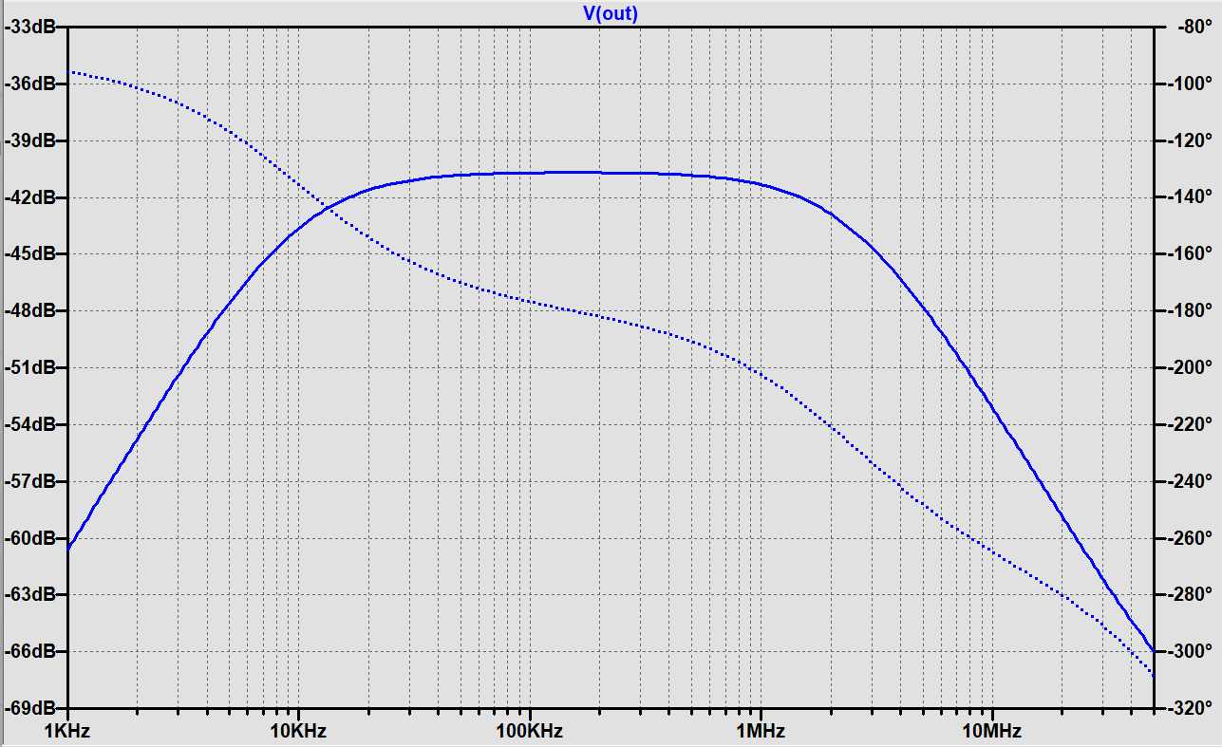
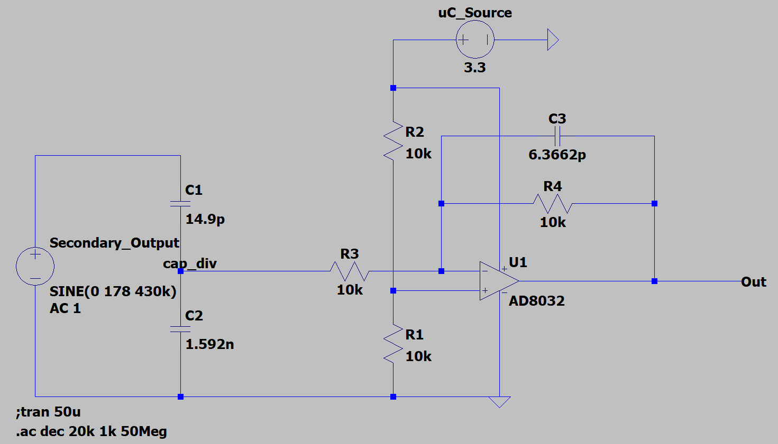
Voltage Sensor: Calculations
Capacitor Divider:
C1: 15 pF
C2: 1.6 nF (1600 pF)
Low Pass Capacitor:
C3: 6.2 pF
Notes:
Daniel
The capacitor divider ratio was calculated based on a peak 178V (356V peak-to-peak) because Medtronic suggested that we account for a 10% swing in our -168V to 168V signal
The reason as to why we chose a capacitor divider is to block the DC Bias that is input to the plus terminal of the opamp (virtual short) from flowing back into the circuit
It was found through frequency analysis that there is a high pass response that is being created by the output capacitor of the capacitor divider and input feedback resistor. Therefore I implemented a 10k Ohm resistor in order to get a cutoff frequency at 10kHz (much lower than our operational frequency at 430kHz
Due to the dead time added to ensure that we don’t short our MOSFETs of the phase shifted full-bridge, we get a pseudo-square wave with a delay. Due to this, the Fourier Series varies slightly from the ideal square wave which may result in elements of the third harmonic to slip past our LCC filter (approximately 13% of the fundamental even assuming a generous 10x attenuation for our filter). Therefore, to ensure a flat gain for the third harmonic, we added a low pass characteristic at 2.5MHz (just below the 5th harmonic) using C3 and the feedback resistor (R4).
The Bode plot on the right shows a total sensor gain of -40dB (1/100) at both our switching frequency and the third harmonic which is what we expect given our capacitor ratio.
The opamp chosen was the AD8031. We chose this opamp as it had a very high GBW at 80MHz, hence we wouldn’t have to worry about our opamp giving us a troublesome lowpass response.

Slide 23
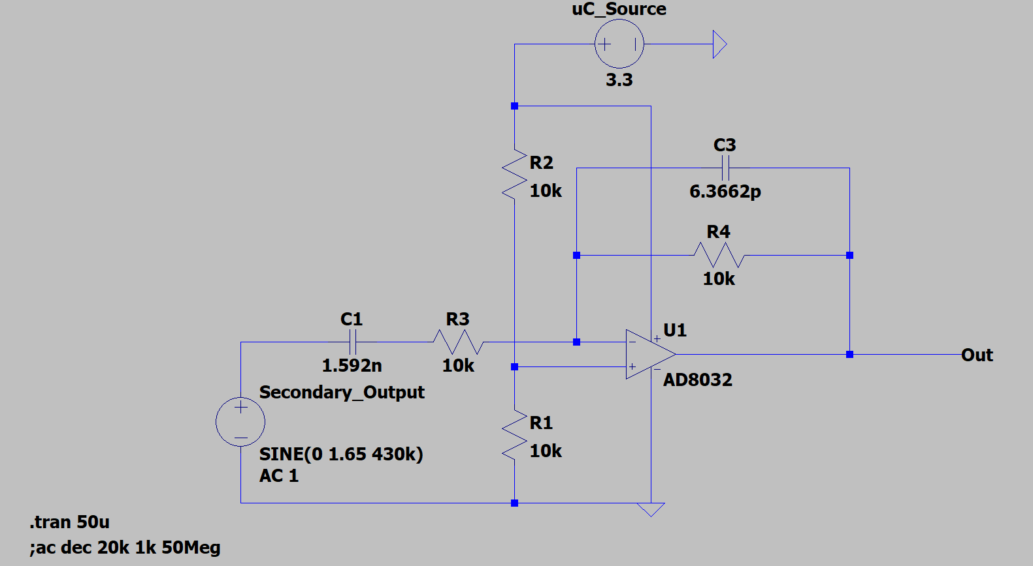
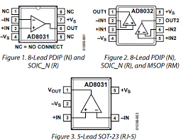
Current Sensor: Calculations & Tech
AD8031 utilized for both sensors
High GBW product 80 MHz
Single rail supply 2.7 - 12 V
Notes:
Daniel:
The current sensor will be input with a voltage that is within the ADC’s range. Scaling the voltage down to this range is done with the sense resistor. In the code, we will use these voltage measurements and divide them with our sense resistor value (at the moment around 22.77 Ohms using a 36 and 62 Ohm resistor in parallel) to find the current measurement.
Specifications:
5.5A RMS (accounting for 10% variation)
7.778A Peak
Using this current and the necessary voltage to get a drop we desire to scale the voltage down to an acceptable range for the ADC, we get that the sense resistor would be approximately 22.67 Ohms using Ohm's law.
Sense Resistor:
22.78 Ohms can be achieved with 36 Ohm and 62 Ohm resistors in parallel
caps and op-amp resistors: same as voltage sensor

Slide 24
System Diagram
Notes:
Steven

Slide 25
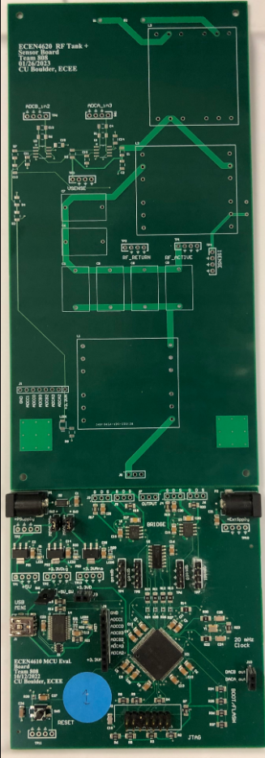
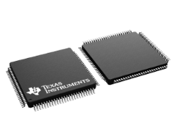
Piccolo 280049C
Control Law Accelerator (co-processor）
Serial Communication Interface (UART)
Direct Memory Access (ADC results)
ADC (Voltage & Current Sensor)
ePWM (RF tank)
Figure: F280049CPZS
Figure: Custom Board with F280049CPZS uC
Notes:
Steven
mcu unit
ADC features
Direct Memory Access Features
Control Law Accelerator (CLA) Features
SCI features

Slide 26
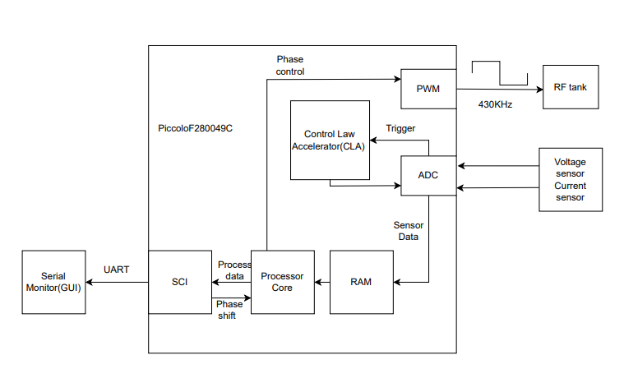
Software Diagram
431KHz
Notes:
Steven:
interrupt state machine type thing
talk about development, block diag for signal flow, timing

Slide 27
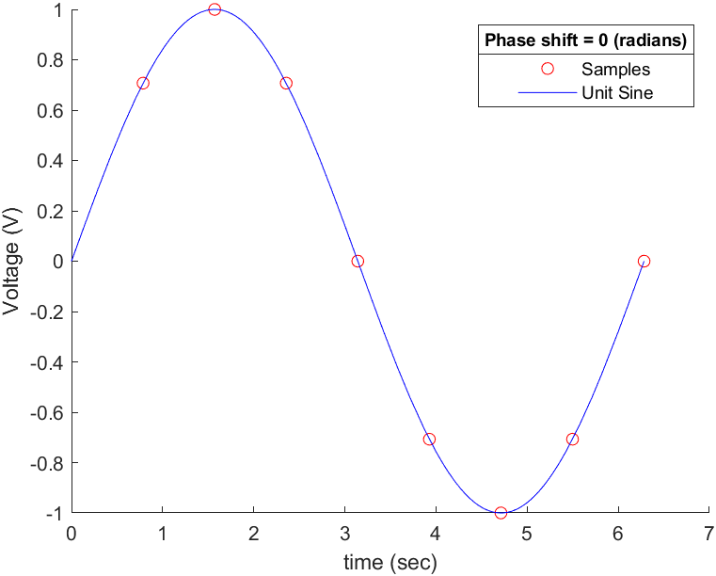
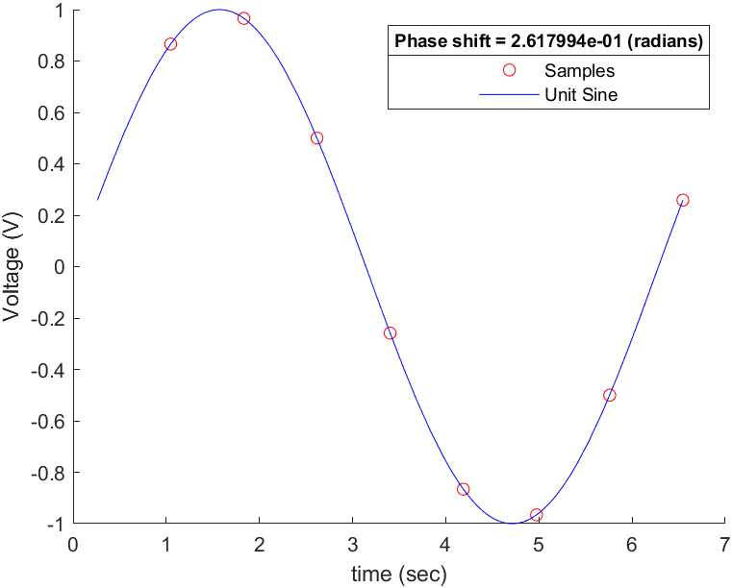
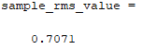
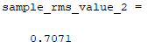
RMS Sampling Example
[1]
[2]
[1]: Unit sine wave sampled 8 times over one cycle with no phase shift
[2]: Unit sine wave sampled 8 times over one cycle with 15° phase shift
Notes:
Noah
Here are two unit sine waves that have been sampled 8 times over one cycle. The figure on the left shows the signal with no phase shift and the figure on the right shows the signal with a 15 degree phase shift. As you can see, both sin

Slide 28
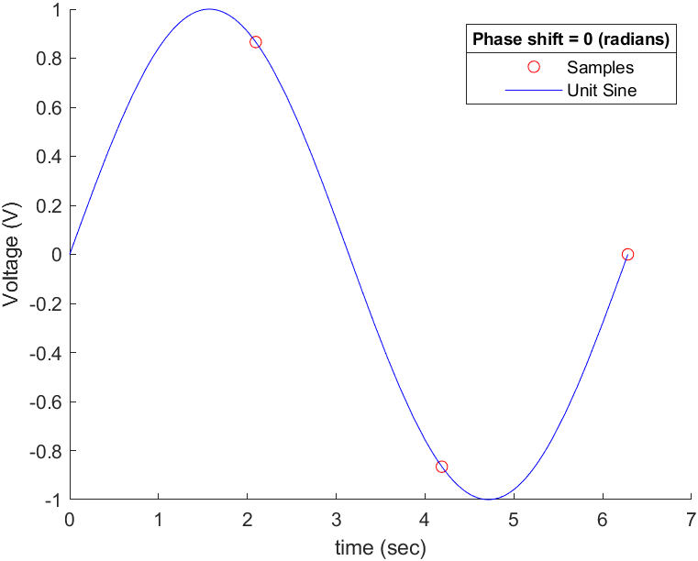
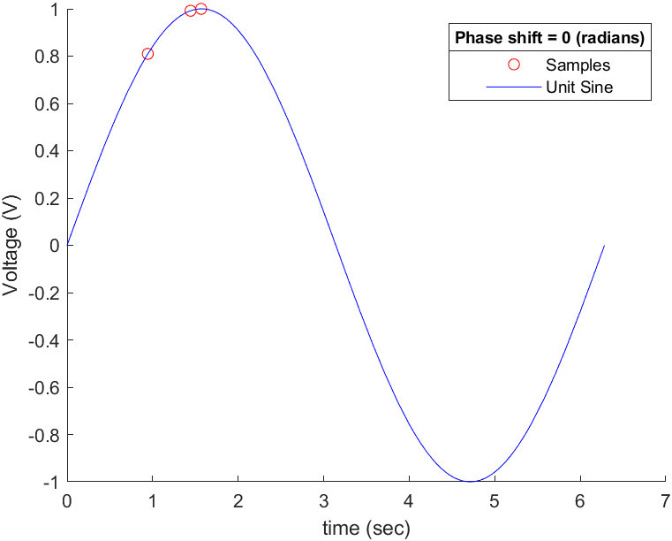
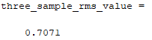
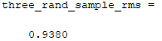
RMS Sampling Example
[3]
[4]
[3]: Three evenly sampled points on unit sine wave (no phase shift)
[4]: Three randomly sampled points on unit sine wave (no phase shift)
Notes:
Noah
With just 3 sampling points that are evenly sampled apart, we can achieve an rms value of 0.7071. If there are less than 3 points, the rms value will change and with uneven or random spacing, the rms value changes as well. Similar to the 8 samples, a phase shift will not affect the evenly sampled rms value as well.

Slide 29
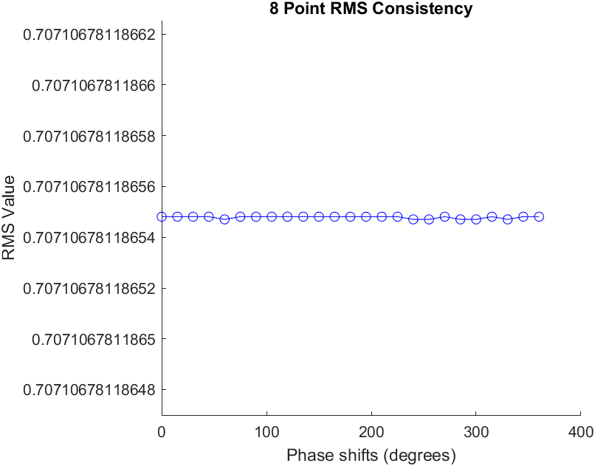
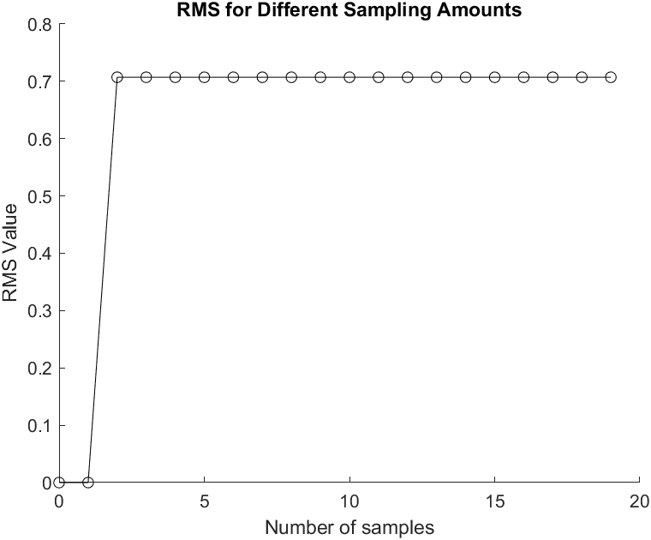
RMS Sampling Consistency
[5]
[6]
[5]: 8-point RMS calculations for 15 degree phase shift increments
[6]: RMS values for varying number of samples (no phase shift)
Notes:
Noah

Slide 30
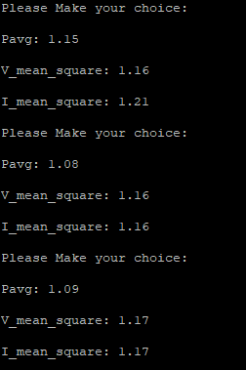
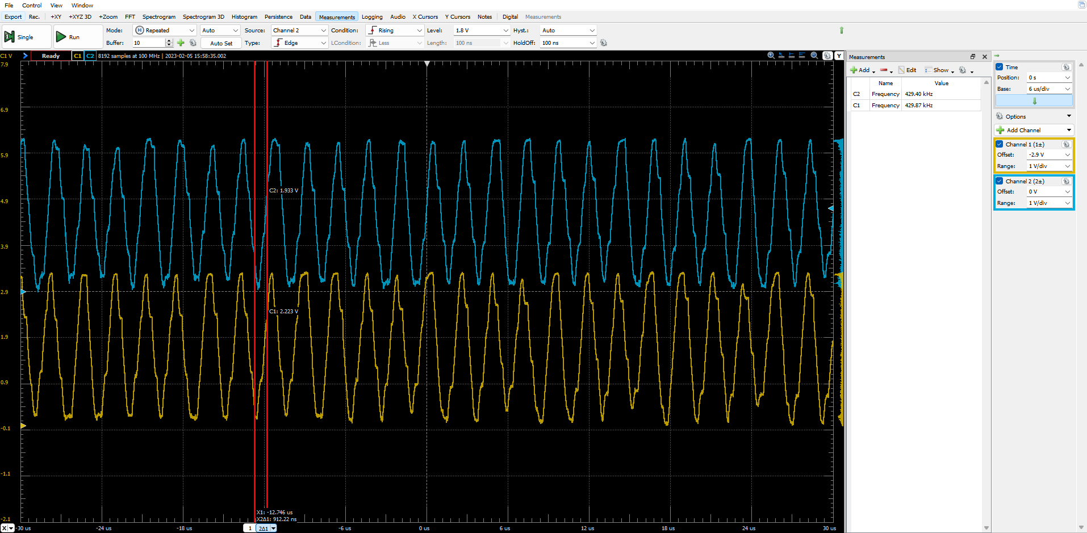
Next Step in Software
Integration test: Fed the signals that come from our sensor circuit to our 2 ADC and verify the correctness.
Integration test: Test and verify the interface between serial port and GUI.
Notes:
Steven

Slide 31
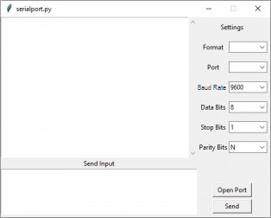
GUI Functionality
Embedded Serial Monitor
Standard Codes
Export Data
Spreadsheet
Graph
Notes:
Ali
the gui will be made to emulate existing medtronic software. There will be an embedded serial port, and it will accept predetermined codes which are already in use. for ease of use, the surgeon will have the option to export the rms data calculated by the uC as a spreadsheet or graph, which will provide intuitive troubleshooting and medical data collection

Slide 32
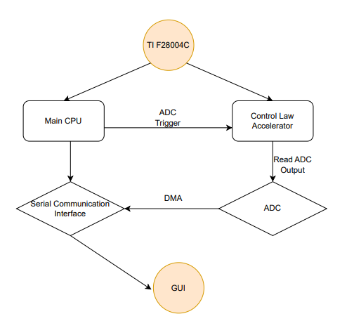
Performance - Tech Highlight (CLA)
CLA acts as a co-processor
Same Clock Frequency as the Core-100MHz
Can Have up to 7 Tasks that work
simultaneously
We don’t have to interrupt the Core to read the ADC
Notes:
Steven - CLA acts as a second core

Slide 33
Lessons Learned
Prepare for project scope flexibility
Cross-check design calculations
Thorough requirement documentation and understanding
Simulate with non-ideal hardware
Save progress backlog
Notes:
Ali
we have learned that we must have flexibility for the project scope, as ours has changed a lot since the beginning of the year. We also learned to have thorough requirement documentation, and ask for the “why” behind them ahead of time. Cross checking calculations and simulating with non-ideal hardware go hand in hand, as we began simulating with the ideal components provided by ltspice and as a result had to go back and make design changes. Saving a progress backlog is a simple method to ensure everyone is on the same page, and there are no communication errors between our us and sponsor, which is a problem we had in the past.

Slide 34
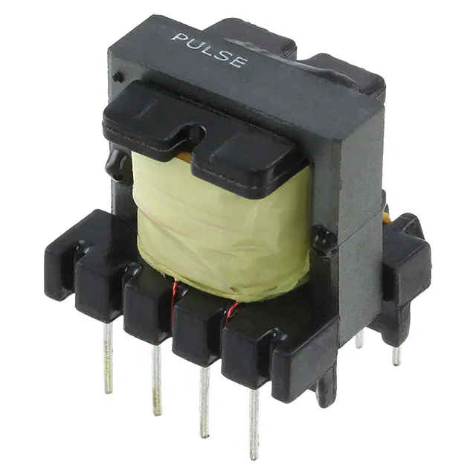
Remaining Risks
Risks:
Housing frame
Power push button
Final PCB
Transformer design
Mitigation:
COTS - frame, transformers
Power via software
Jumper two existing boards together.
Notes:
Noah
Unfortunately, none of our team has experience with any sort of CAD software, hence, designing a custom frame presents uncharted territory
Magnetics design, while many of our teammates have taken an introductory course to power electronics, we are still not familiar with magnetics design. Furthermore, we weren’t given the same specifications from Medtronics as opposed to the style of problems we saw in homeworks and the textbook for ECEN4797.
Final PCB: intended to combine controller board + RF tank w/ sensor
Mitigation:
We could mitigate the first risk by modifying an off-the-shelf frame provided by Medtronic. Furthermore, we could construct a rudimentary frame ourselves using the laser cutter at the ITLL
We have all calculations set for our inductors and transformers, hence, in the case that we have trouble constructing the magnetics themselves, we would simply request Medtronic to construct the inductor and transformers for us
Mitigation for Final PCB is not having it and only using the existing 2 boards

Slide 35
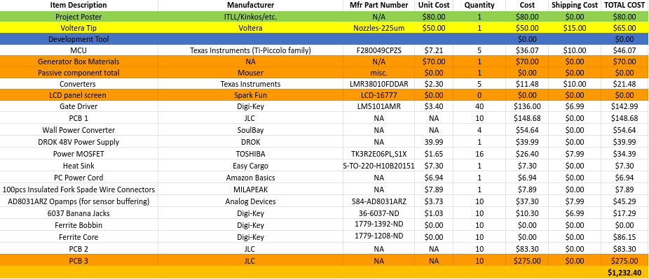
Budget
Notes:
Ali
final pcb, passive components, generator box

Slide 36
Schedule
Date | Development Objective
02/16 | -Python GUI has interface similar to Putty that’s been used. Proper RMS Calculation combined with GUI operation
03/02 | -Magnetics completely built for RF Tank testing (inductor, step-up-transformer, isolation transformer) + generator box 3d design
03/14 | -3rd PCB designed and sent for fabrication (combining the controller board + RF tank w/sensor board)
03/16 | -Full system integration demonstrating the full functionality of the SESU.
04/04 | -Build up combined PCB + have generator box completed
04/13 | -Acceptance Test Demo
04/21 | -Finish EXPO Poster and send for printing
04/28 | Expo
Notes:
Ali

Slide 37
Q&A

Slide 38
Appendix

Slide 39
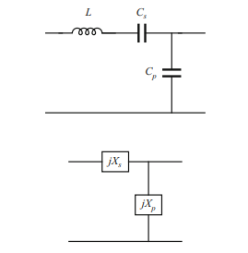
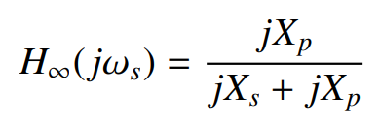

RF Tank Design Process
SPECS:
Max voltage: 115V RMS
Max current: 5A
Max power: 100W
Input voltage: 48V
Switching frequency = 430 kHz
Find the fundamental peak and fundamental rms voltage values
Reflect the load and find output rms voltage and current (secondary side of step-up transformer
Find the two operating voltage and current points on the elliptical
Find open circuit voltage and short circuit current using the two operating points (voltage and current
Find open circuit transfer function
Find open circuit output impedance
Find reactance of the inductor series capacitor and parallel capacitor
Find capacitor and inductor values based on reactance
Notes:
Rustin

Slide 40


Transformer Info
Equations Used
Givens
Givens
Peak Flux Density
B = 200 mT
Core Area
A_c = 162 mm^2 = 0.000162 m^2
C₁ = 8.08nF
C₂ = 34.2nF

Slide 41

RMS Calculations
RMS Voltage for one cycle (8 samples per cycle)
RMS Current for one cycle (8 samples per cycle)
Average power for one cycle (8 samples per cycle)

Slide 42

Software Flowchart
Notes:
Steven:
interrupt state machine type thing
talk about development, block diag for signal flow, timing

Slide 43



Project Objectives
Wall Powered
Powering Ligasure
Supply a 324V peak-to-peak, 430 kHz RF tone to the Ligasure cauterization device
Provide 48V DC power to supply the entire ESU system
Data Streaming/GUI
Space-efficiency
Our goal is to create an ESU that is 6 x 12 inches (existing ESU is ~16x18 inches)
Our goal is to create an ESU that is 10 x 12 inches (existing ESU is ~16x18 inches)
Stream real-time RMS impedance data of flesh-site to GUI
Notes:
Sonal

